Slide 1
Digital Library Management
Teacher : Miss nida munawar
and
Lab Teacher: sir muhammad sohail afzal
Members:
1. Muhammad zubair
2. Kulzum Mujtaba

Slide 2
Why library management system?
Due to the changing nature of librarianship resulting from the increasing amount of Books. Its hard for library staff to manage it properly. Also it consumes time and more workers with lot of paper work like for taking details for issuing books. this project can make easy for users as well as staff:
1. To improve library use services
2. To reduce paper work
3. Book wise search can be performed
4. More accuracy

Slide 3
Problem statement :
We decided to work on this project as we see the following problems occurs:
1. In the library management due to manual management still in this computer era .
2. Its also Time consuming.
3. Searching records is a challenging work.
4. Cant access to the resources available immediately.
5. Maintaining registers is complex.
6. Updating records is a tedious work

Slide 4
Solution :
The system will allow performance of the actions needed in order to manage the library in a simple and comfortable way .The actions will be included addition of the books ,book searches , issue books and many more .The administration in parallel to user actions keeps a basic security level which prevents the access or modifications of data by user which don’t possess the proper permission .

Slide 5
Programming Concepts Use:
The concepts implemented in our library management system includes
Classes , inheritance (hierarchal ), composition (has a relationship ) and also (is-a relationship), filing (the most import part of the project), encapsulation, abstraction ,friend function, arrays, conditional statements, data hiding,default explicitly called constructors

Slide 6
Libraries used:
1. #include<iostream>
2. #include<stdio.h>
3. #include<string.h>
4. #include<fstream>
5. #include<iomanip>
6. #include<conio.h>
7. #include<stdlib.h>

Slide 7
Key features:
Global Functions:
1. Main menu
2. Search menu

Slide 8
Student Class :
Functions which are used in student class
1. Search book(by book id or book title)
2. Issuance of books
3. Display issued books

Slide 9
Administration Class:
1. Requires password
2. Search book(by book id or book title)
3. Modify book details
4. Add book
5. Display all books
6. Issue books

Slide 10
UserInterface Class:
1. void issue();
2. void displayissued();
3. void issuance(char[], int);
4. void heading();
5. void searchByID();
6. void searchByTitle();
7. void header ();
8. friend void searchMenu();

Slide 11
Program Inheritance:
Class UserInterface
Class Admin
Class Student
Class Book

Slide 12
Class Diagram:
Class UserInterface
Functions:
1.issue()
2.isplayissued();
3.issuance(char[], int); 4.heading();
5.searchByID();
6.searchByTitle();
7. header ();
8.searchMenu();
Class Admin
Attributes:
1. char name
Functions:
1. password();
2. staffManagement();
3. modify();
4. menu();
5. earchMenu();

Slide 13
Class Diagram
Class Book
Attributes:
1. char Title
2. Author
3. BookId
4. Department
Functions:
1. getID
2. getTitle
3. getAuthor
4. getDepartment
5. getBook
6. addBook
7. showBook
8. displayBooks
9.istView
Class Student
Attributes:
1. name
2. rollNo
Functions:
1. student();
2. menu ();
3. searchMenu ();

Slide 14
Book Class:
1. Getter functions
2. void getBook();
3. void addBook();
4. void showBook();
5. void displayBooks();
6. void listView();

Slide 15
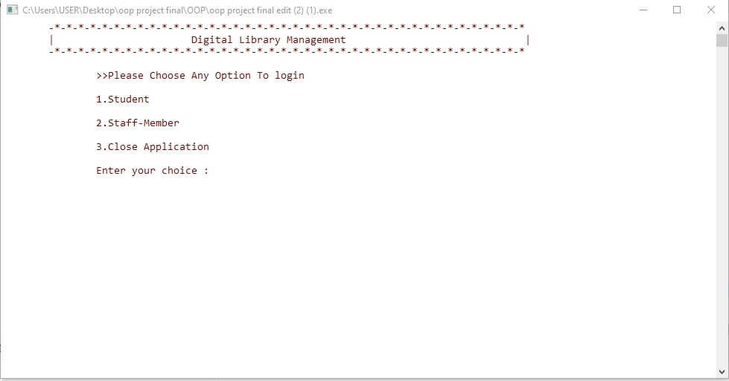
Main Menu: This function is to entering as a Admin or Student User.

Slide 16
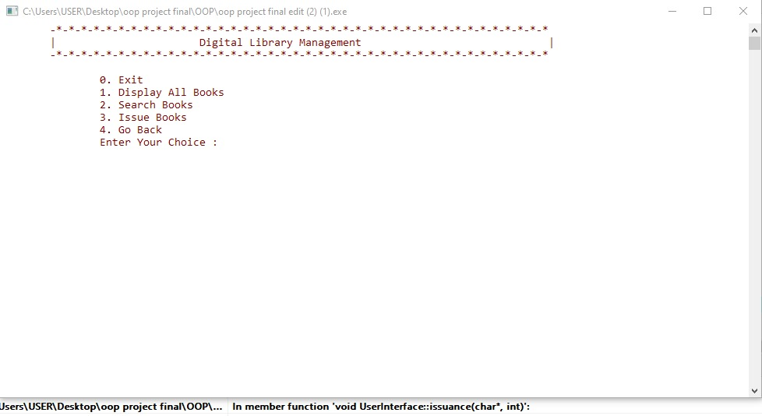
Student: This function is for Students Users.

Slide 17
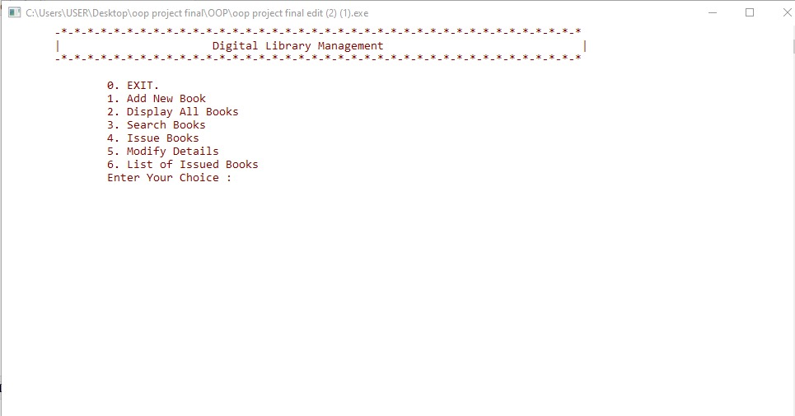
Admin: This function is for Staff Users.

Slide 18
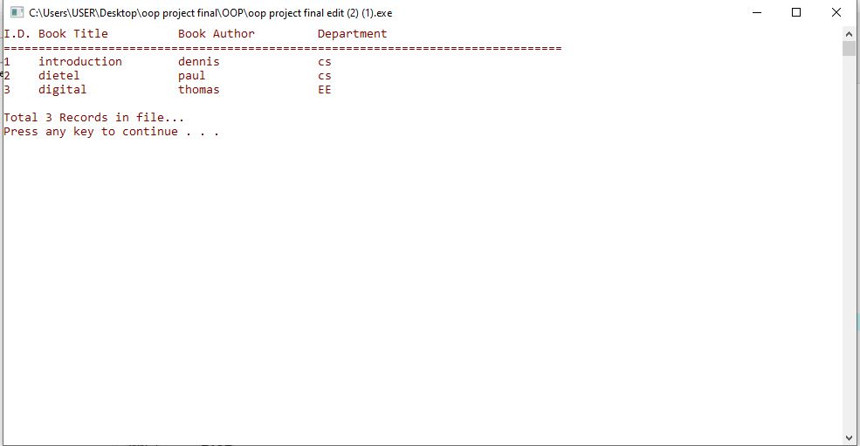
Display Books: This function is for displaying all available books.

Slide 19
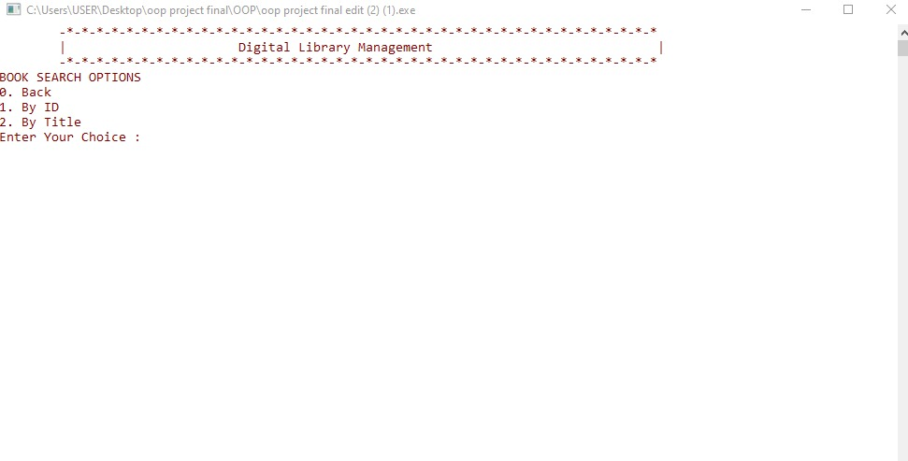
Search Books: This function is for searching the books by their ID or Title by the choice of user.

Slide 20
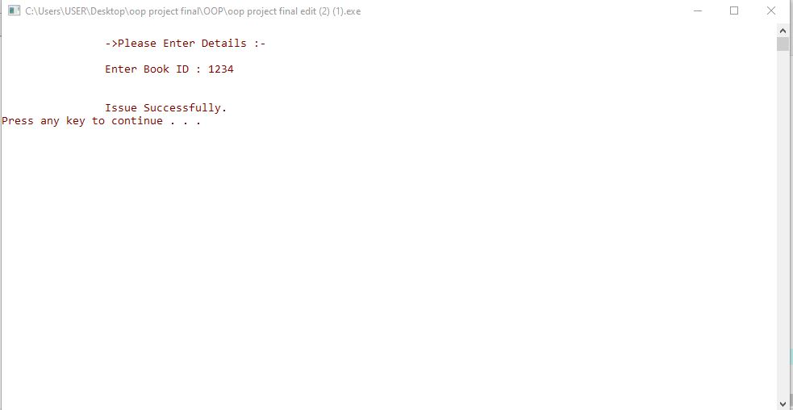
Issue Books: This function is for to issue or reserved the books.

Slide 21
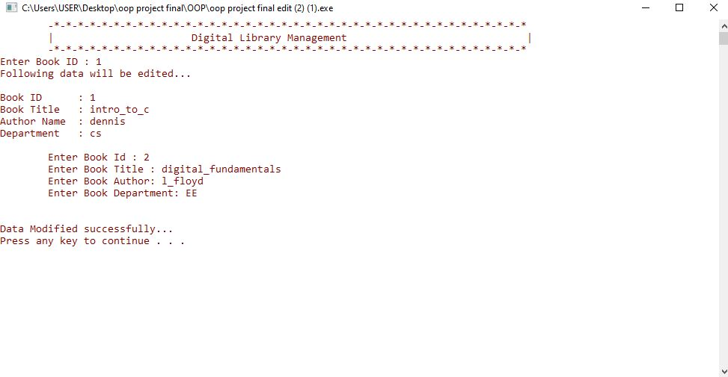
Modify Books: This function is for updating the details of available books.

Slide 22
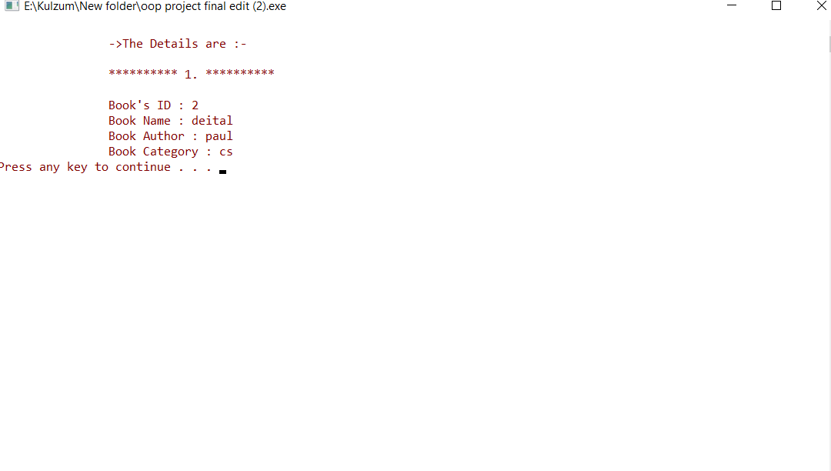
Issued Books: This function is for displaying all books which are reserved by any Student or Admin user.

